Slide 1




NPCs
Jennifer Duarte, Shambhawi Sharma, Inika Singh, Bridget Torres
Notes:
Inika

Slide 2
01
Introduction
Notes:
Inika

Slide 3
Introduction
BuddyZen is an app that helps students organize their schedules. It features a planner with a calendar, displaying classes with start and end times, and assignment due dates. Students can prioritize and mark assignments for efficient time management. BuddyZen sends reminder notifications for upcoming due dates. Additionally, it allows grouping different activities like club events in separate categories for easy organization.
Notes:
Inika

Slide 4
User Categories
Students (Primary User)
Educators/Teachers
BuddyZen targets students across different educational levels. It serves as a comprehensive tool to effectively manage academic schedules, assignments, and priorities.
BuddyZen offers valuable support in maintaining organized schedules, managing class assignments, and noting important dates.
Administrators
General Users (All-Inclusive)
BuddyZen enhances the productivity of this user category by efficiently managing work schedules, meetings, and essential tasks through an intuitive and streamlined interface.
BuddyZen extends its utility to a broader audience, enabling them to organize their daily tasks and goals effectively.
Notes:
Inika

Slide 5
02
Context Model & App Interaction
Notes:
Inika
Just add images here lol

Slide 6
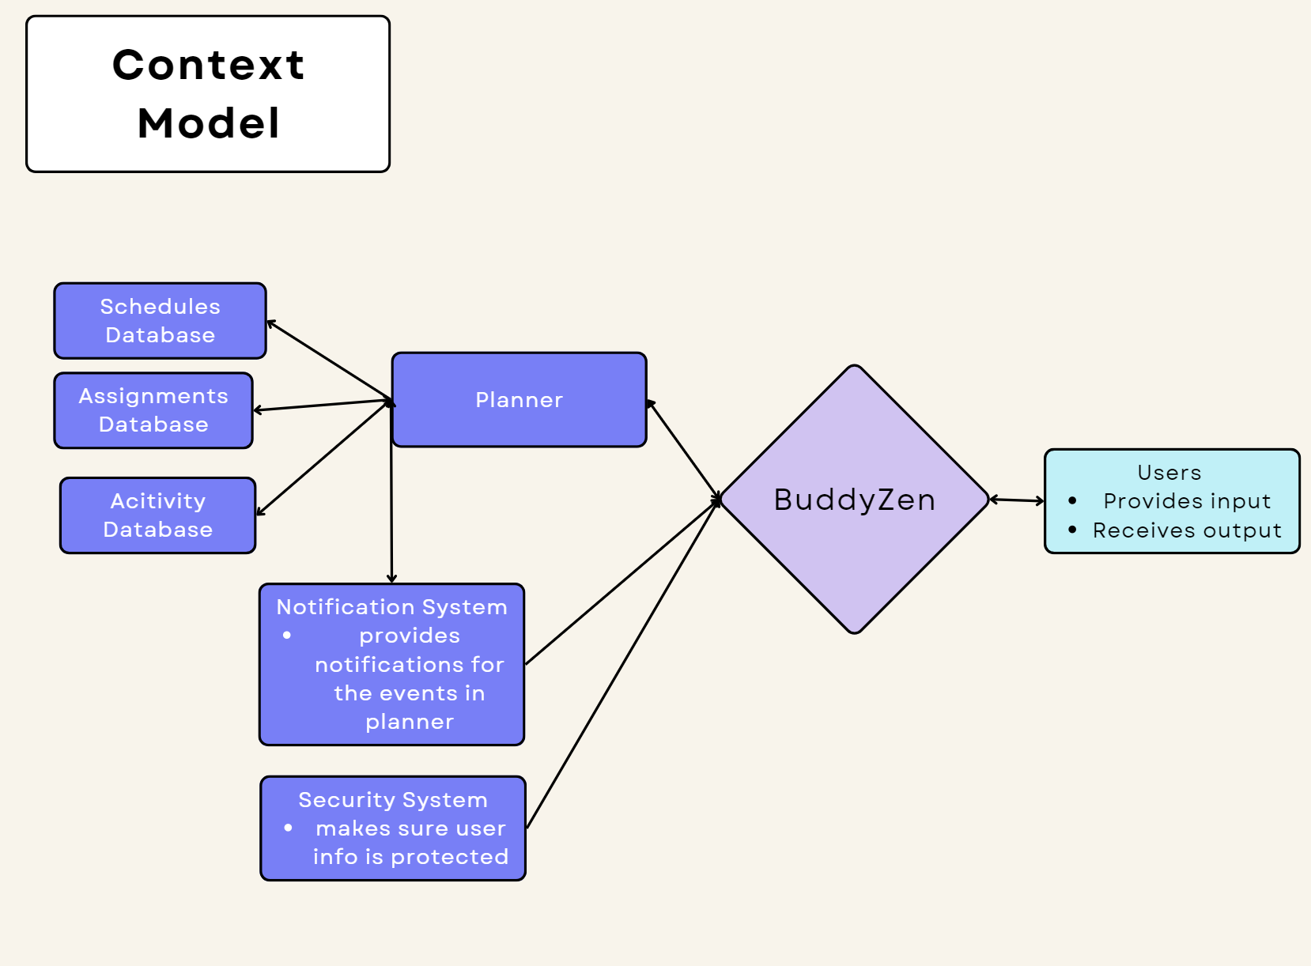
Notes:
Inika
Above we share the context and system model for BuddyZen and it offers a description of how the application will interact within the broader system as it interacts with the various elements in its environment. The context model emphasizes BuddyZen’s core functionalities, including its ability to schedule events, set assignments in the planner, and have a reminder feature for events providing a clear illustration of how the program interacts with different components and creates a cohesive user experience. Likewise, the model explores the relationship and interaction between BuddyZen and the other components within the academic ecosystem. This overall outlines the information flow through the app’s integration with the notification system, planner layout, and security system. Therefore, this provides a transparent overview of how BuddyZen seamlessly integrates into the larger system. It highlights the central role of the app as a fundamental component in providing an efficient and effective time management system for students in their academic pursuits while providing security through the entire process of receiving and providing information.

Slide 7
03
Prototype Overview
Notes:
Mochi

Slide 8


Logo and Color Scheme
Notes:
We have opted for a sky blue shade that is calming, along with our brand logo on the main page.
MOCHI

Slide 9
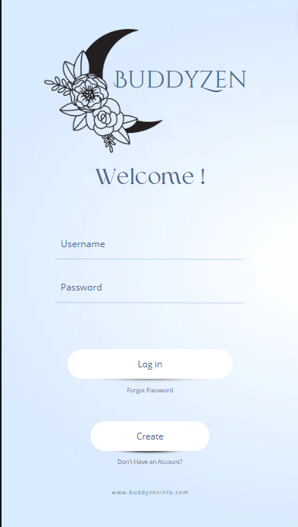

Login page
Prompts the user to enter their login credentials.
If the user forgot their password or has yet to create an account, the user can select the Create button.
Text fields are provided in the UI so that the user may enter their details and log in.
If user enters an invalid input, an error message is displayed to the user to re-enter their information.
Notes:
Mochi

Slide 10
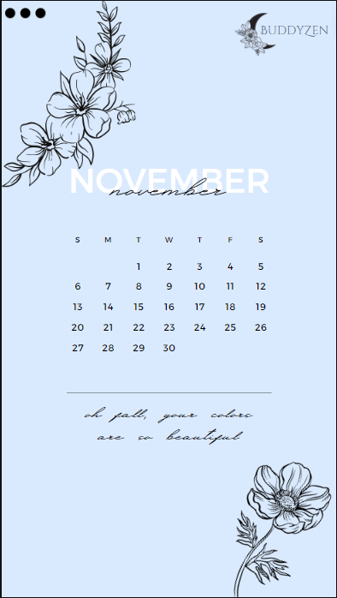
Central Calendar View
Main Dashboard
Presents an organized overview of the user’s schedule.
The central area features a monthly calendar view.
Consists of motivational quotes and refreshing graphics, enhancing the users experience.
Notes:
Mochi
Consists of motivational quotes and refreshing graphics, enhancing the users experience by improving the users mood and mindset.

Slide 11
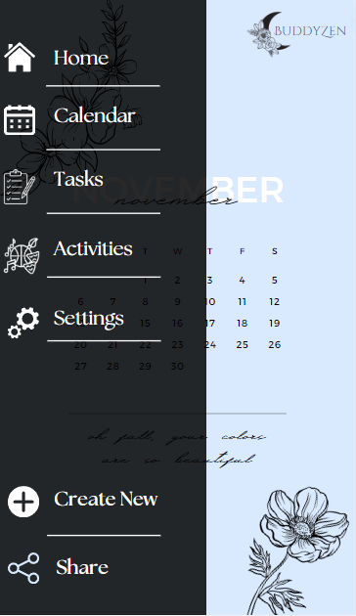
Sidebar View
Sidebar view is displayed after pressing the three dots at the upper left of the main dashboard.
Consists of tabs for Calendar, Tasks, Activities, and Settings
Provides quick access to priority tasks and upcoming deadlines
Users can add new tasks with a clear “Create New” button
Users can share the calendar with another user on the app by selecting the “Share” button.
Notes:
Mochi

Slide 12
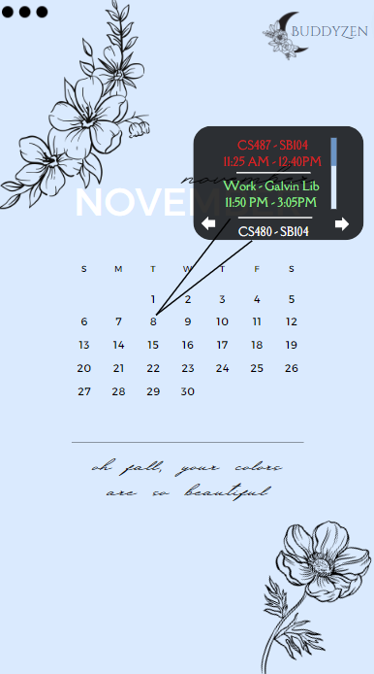
Scrollable event popup
Appears after clicking on the date.
Contains a list of all past and upcoming schedules.
Schedules that are past appear in red, immediately upcoming schedules show in green, and later schedules are all white.
Arrow buttons are provided on either side of the popup to help navigate between different dates quickly without needing to press the date itself.
Notes:
Mochi

Slide 13
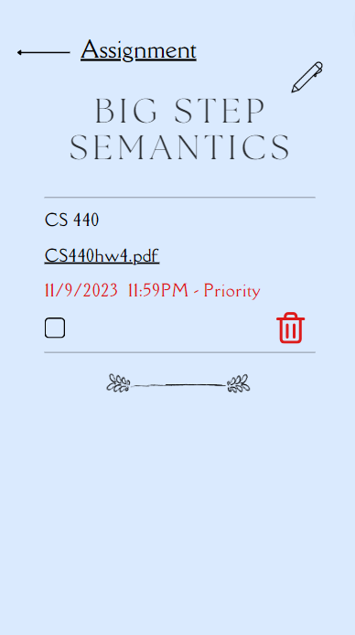
Assignment View
Each task can be categorized by type (assignment, personal, club-related).
Priority levels are easily adjustable by selecting the pencil symbol to edit.
Checkbox allows users to mark tasks as complete.
The interface also supports drag-and-drop functionality for effortless task rearrangement.
Assignment events display due dates and associated courses, while extracurricular events provide information on the club, location, and time.
Notes:
Mochi

Slide 14
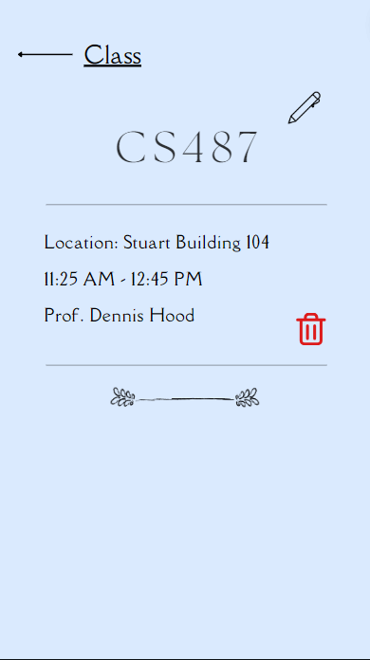
Class View
Clicking on a calendar event opens a detailed view.
For classes, it shows the course name, location, and professor details.
Users can quickly edit or delete events directly from this view, enhancing the overall user experience.
Notes:
Mochi

Slide 15
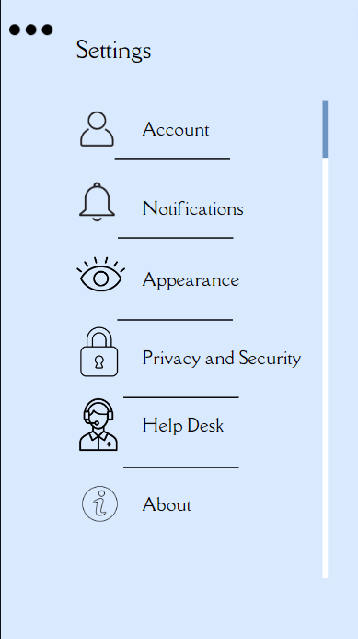
Settings View
Settings view consists of tabs for Account, Notifications, Appearance, Privacy and Security, Help desk and About.
User is able to find their profile information and customization options.
Settings view allows users to set preferences for notification timings, choose app themes, and manage account details.
The UI ensures a straightforward and visually appealing layout.
Notes:
Mochi

Slide 16
Notification Center
Feedback Loop
Notification Center and Feedback Loop
A Notification Center is accessible from the top navigation bar.
Users can view and manage reminders, with options to snooze or mark them as completed.
The notifications are color-coded (red for almost due events, green for soon-to-be-due events, and white for others).
Integrated into the UI is a subtle feedback button allowing users to share their experiences, report issues, or suggest improvements.
Feature reinforces BuddyZen's commitment to continuous enhancement through user input.
Notes:
Mochi

Slide 17
04
State Transition and Workflow
Notes:
Mochi

Slide 18
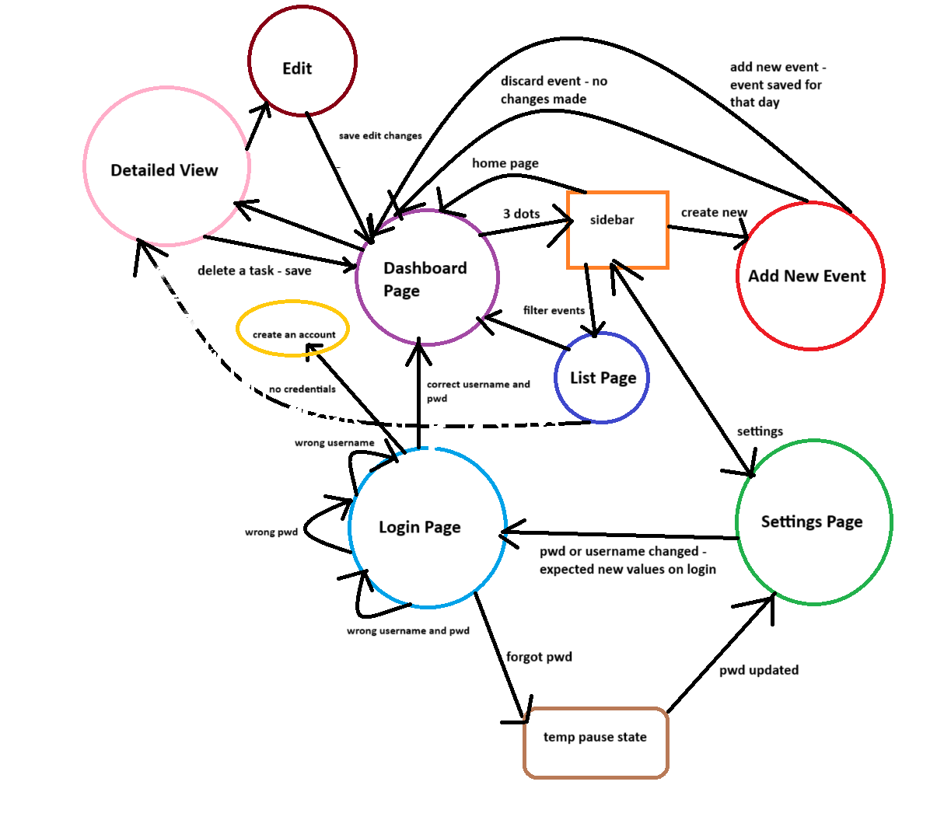
Notes:
Mochi

Slide 19
05
Non-Functional Requirements
Notes:
Inika
Multiple design approaches have been taken to meet the non-functional requirements for BuddyZen and make it an application that possesses quality and behaviors that favor the benefit of the user. Some of the non-functional requirements that helped the application become user-friendly are mentioned as follows.

Slide 20
Security
The application requires users to have a login and password in order to ensure the security of their data.
Each password needs to be at least 8 characters in length including upper and lower case alphabets, one or more digits, and at least 1 symbol. This strategy will reduce the risk of having common and easy passwords therefore reducing the risk of someone hacking into the system with a user’s login.
Data encryption will be implemented to ensure the security of the user data while being transmitted and stored to keep schedules, assignments, and activities confidential.
Notes:
Inika

Slide 21
Performance
The performance of BuddyZen is ensured by its response time.
Whenever the user adds to the planner, they are instantaneously added to the calendar.
The response time will be minimal for user interactions and provide for a smooth and actively responsive user experience.
The app will be able to handle multiple users at once since users might be sharing their schedules or planning at the same time. This will happen without compromising this performance as the app can handle a large quantity of users at a given time, making scalability a significant part of the app.
Notes:
Inika

Slide 22
Ease to Use
The User Interface is specifically designed to cater to the user and provide a consistent and intuitive approach to navigating through the app.
The app has a calming background and the interface is straightforward allowing users to easily click through the buttons and make adjustments and modifications to their planner as they like.
Through settings, the user can modify the notifications to their personal preferences.
Notes:
Inika

Slide 23
Reliability
BuddyZen will be functioning all 24 hours of the day providing the users to access their planners at any time of the day regardless of any time constraints.
If the application faces some difficulties in hardware or software it will save the user information in case it crashes
Any issues in the backend will be fixed while the application continues to run.
Notes:
Inika

Slide 24
Compatibility
BuddyZen will be able to function through major browsers such as Chrome or Safari to support a large audience and diverse user preferences.
The mobile responsiveness of BuddyZen will allow it to be accessed and functional on different smartphones or tablets with operating systems such as iOS or Android.
Notes:
Inika

Slide 25
06
Risk Assessment & Exception Management
Notes:
Bri

Slide 26
Potential Failures
Potential failures that may arise during development and usage are possible design errors.
An example of a feature in the app is a customizable calendar, and in order to make it customizable for the user, they must create an account; this might lead to security issues. A priority can be placed on user account information to make the app more reliable for users.
A design error may arise because of the effectiveness of the notification reminders. It is noted that notification issues can arise if during usage the user is able to note if they were not notified of an important task, which can lessen the reliability of the application.
Notes:
Bri

Slide 27
Assessment of Risk Exposure
Risk exposure that may occur in the functionality of the application would be attempts to synchronize calendars to the application. This action can cause issues such as inconsistencies in the synchronization of the calendar, introduction of delays, and issues with data modifications.
Another risk exposure that may arise is the risk of having unauthorized access to users' data. This issue is likely to occur if there is no strong authentication mechanism and a lack of adoption of proactive and holistic approaches to security.
Another risk exposure within the application is the user's experience in the application, since providing a bad experience to users causes users to become disinterested which leads to a loss in the application's user engagement.
Notes:
Bri

Slide 28
Risk Mitigation Actions
Creating a user-friendly environment for the user interface
By making it user-friendly and making it easy for users to navigate through the application, it will not only fulfill the user’s needs but also allow to attract and retain users to the application.
Performing thorough performance testing on the application
This allows to address possible issues during development, this would then minimize the amount of issues that may arise during usage for users.
Security Measures
Regular security assessments that tackles the risk exposure of data security
Include strong login security processes like two-factor authentications.
Notes:
Bri

Slide 29
Exception Management Mechanisms
Invalid user inputs
To ensure that valid information is being given from the user, there should be an exception that listens for those exceptions and then alerts the user to input the proper information.
User feedback
With user feedback, users are able to report issues that might have occurred in the app with information on diagnosis of the issue. User feedback will not only improve the application but also be able to get information on issues that are arising through the application from the user's perspective.
Notes:
Bri

Slide 30
07
H-C-I & C-C-I Protocols
Notes:
Bri

Slide 31
H-C-I Protocols
User interface allows users to adjust their schedules or overall adjust the system however they feel would fit.
Users are capable of setting up their preferences for notification timings, app themes, and managing account details.
The system is able to gather information from the user’s input and be able to adjust itself as necessary from the information provided by the user from the user interface.
Notes:
Bri

Slide 32
C-C-I Protocols
The frontend and backend of the system is able to communicate and interact with one another in order to process and manage information being retrieved from the user.
In the case of a database such as Azure, the application would use either Azure functions (using AJAX calls and RESTful APIs) or Java Applets to allow for function calls.
Database interactions is a C-C-I protocol that enables users to be able to include their schedules and the notification settings in which the system is able to retrieve that information in order to implement that date to update its calendar and notification system.
Notes:
Bri

Slide 33
08
Test Cases
Notes:
jenny

Slide 34
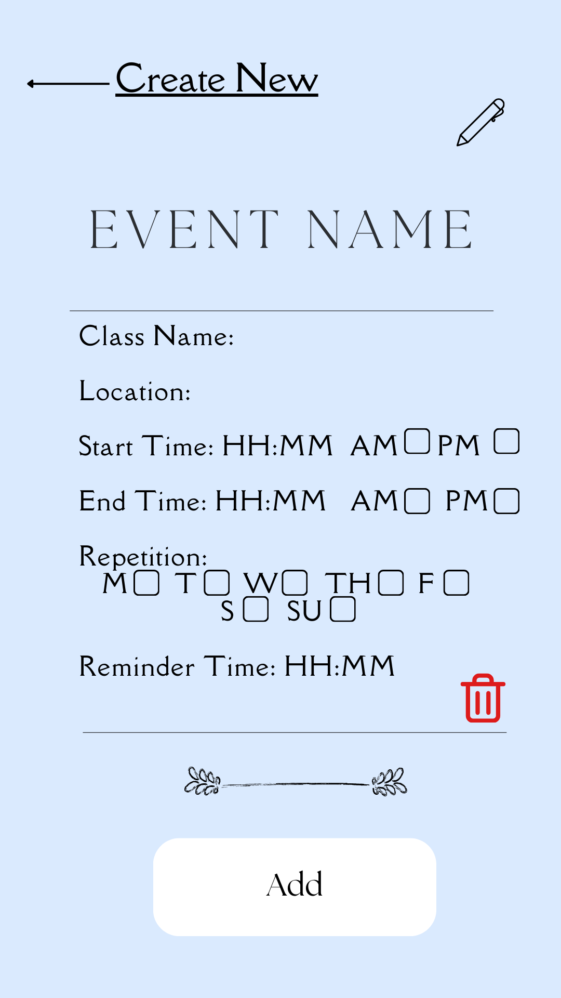
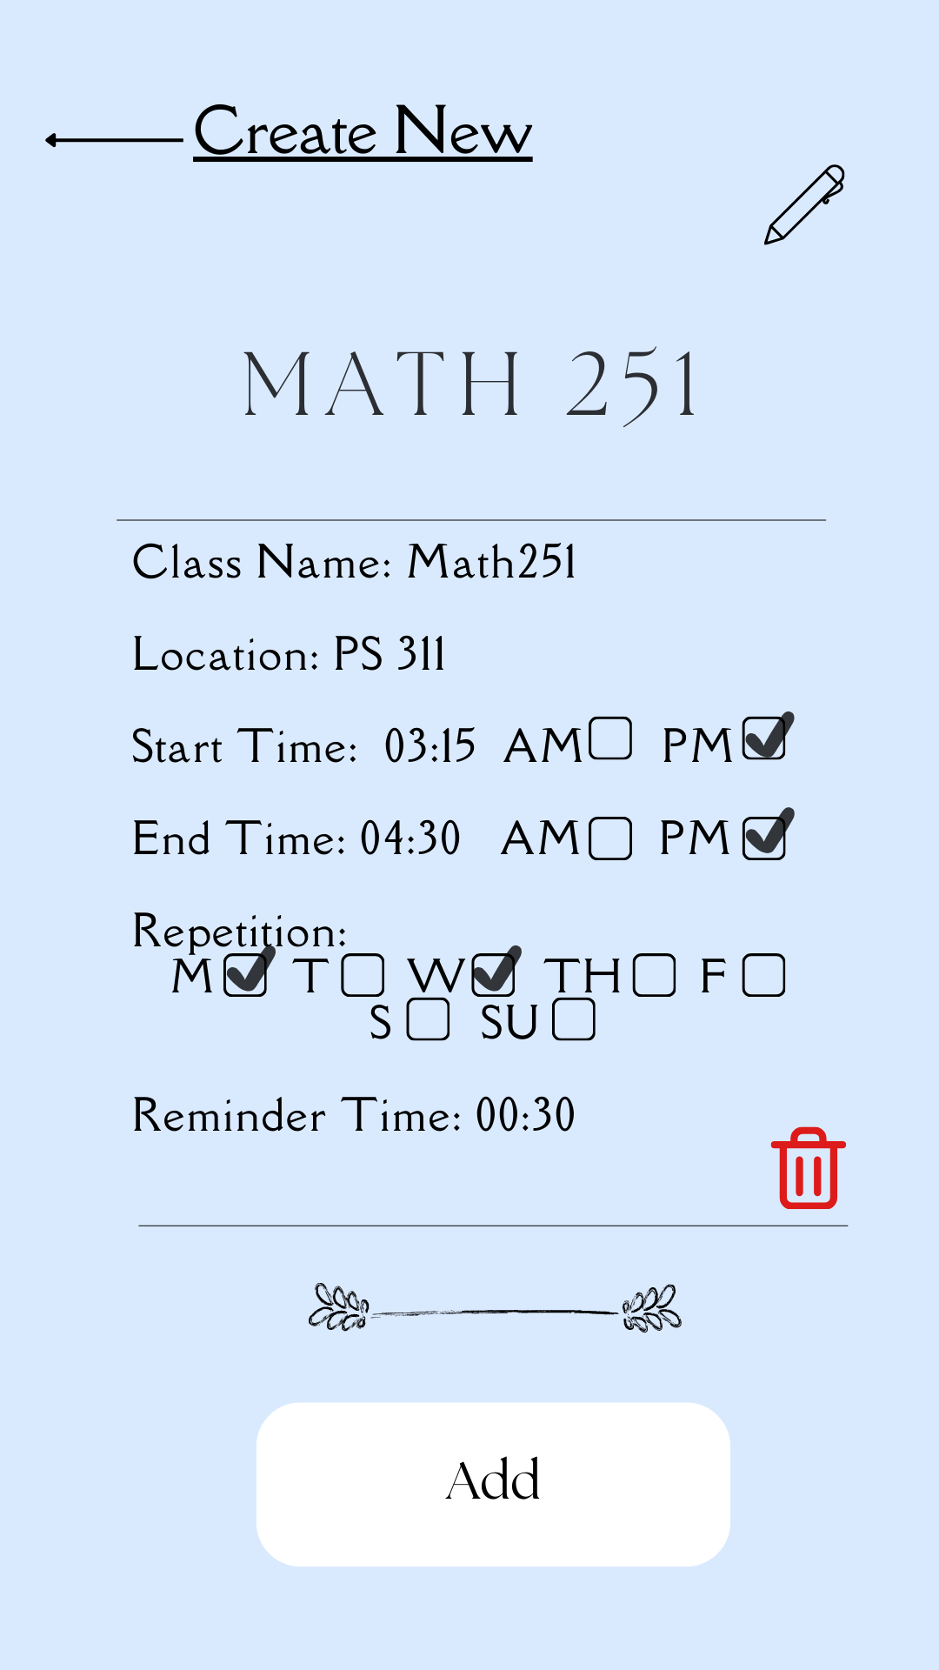
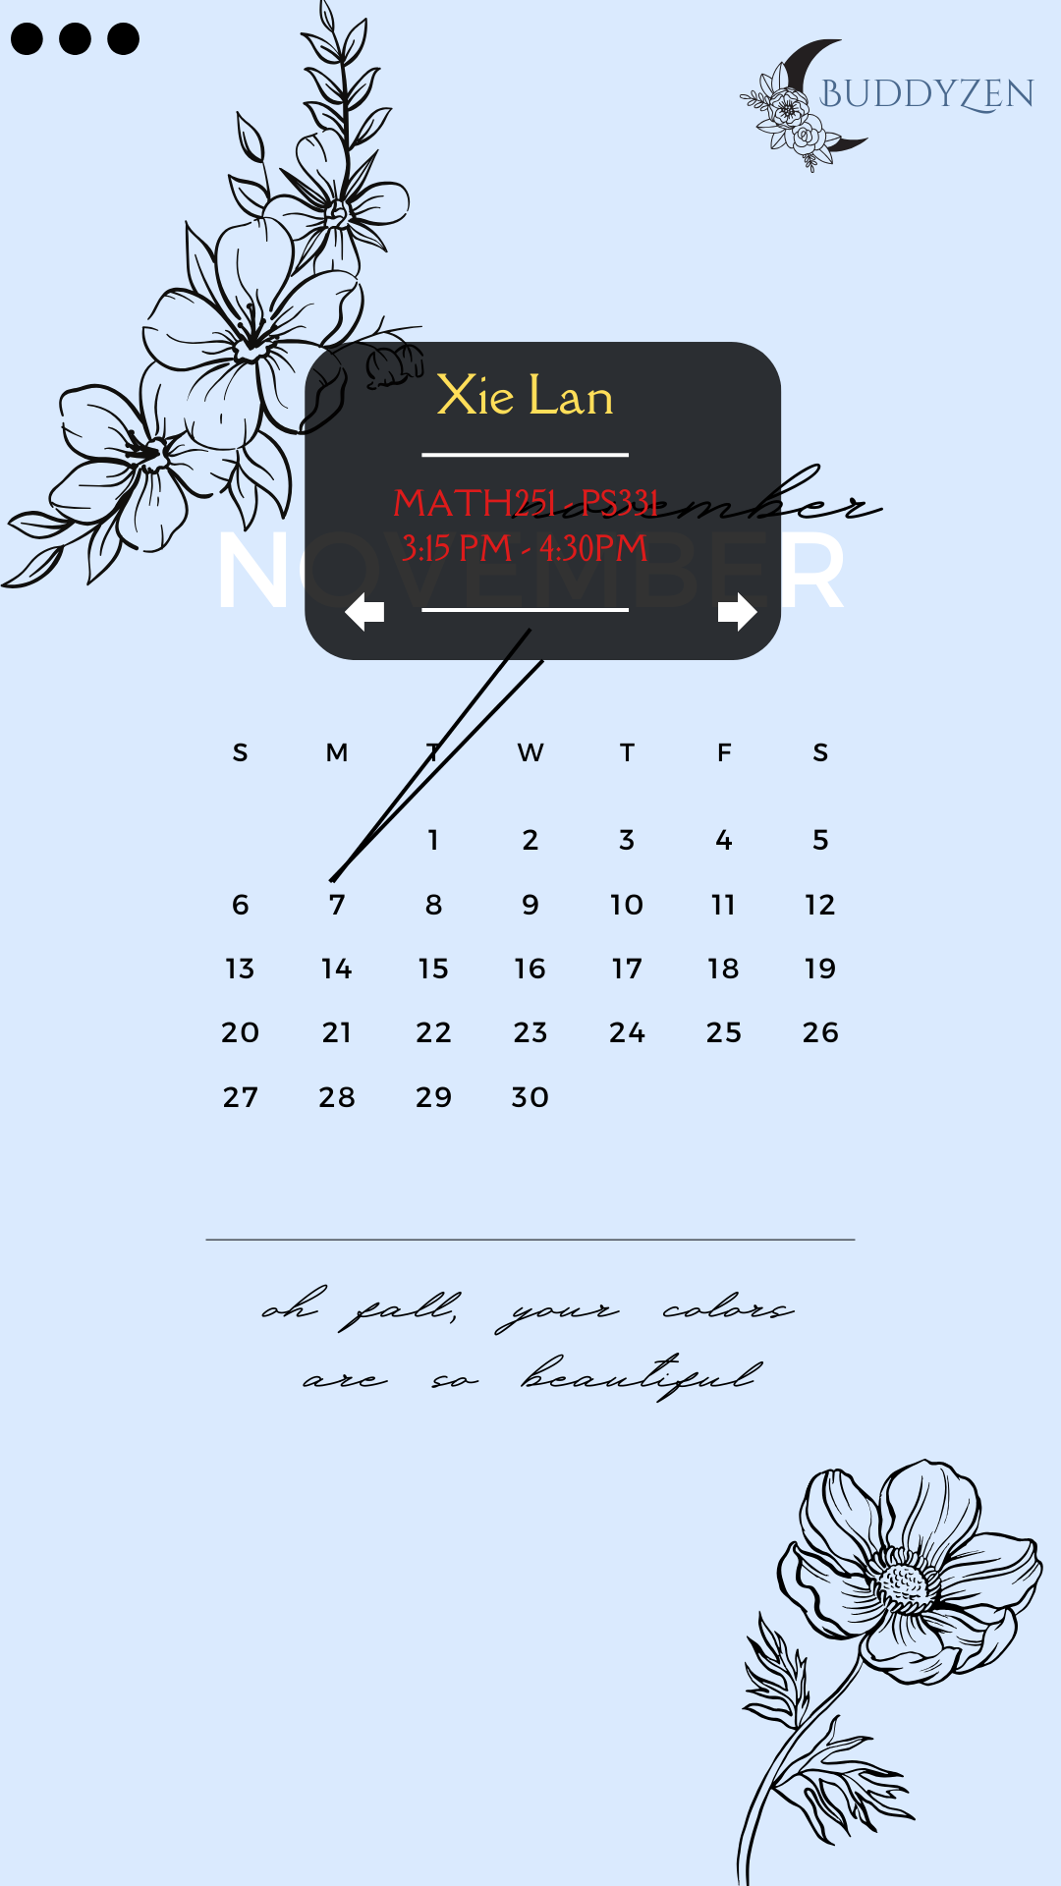
Test Case A
Notes:
Jenny
The user sets up their class times in the schedule, including the starting and the ending times for each class they have in the week. The user will click the create new button and be prompted to fill out information once done they can click the add button and be able to see the class in their calendar with the class location as well as time every monday and wednesday and will be reminded 30 mins before

Slide 35
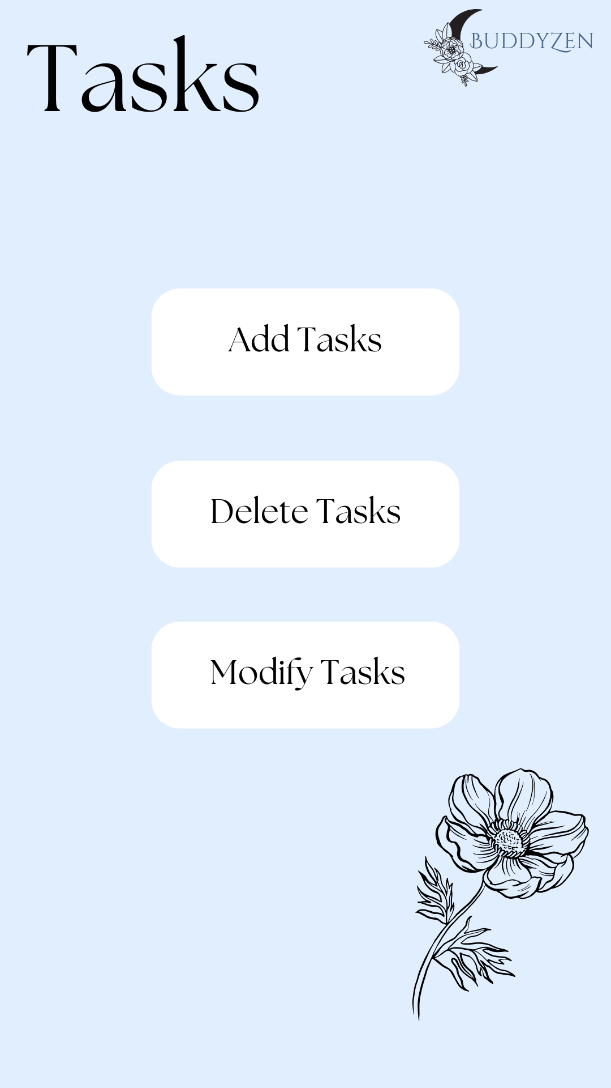
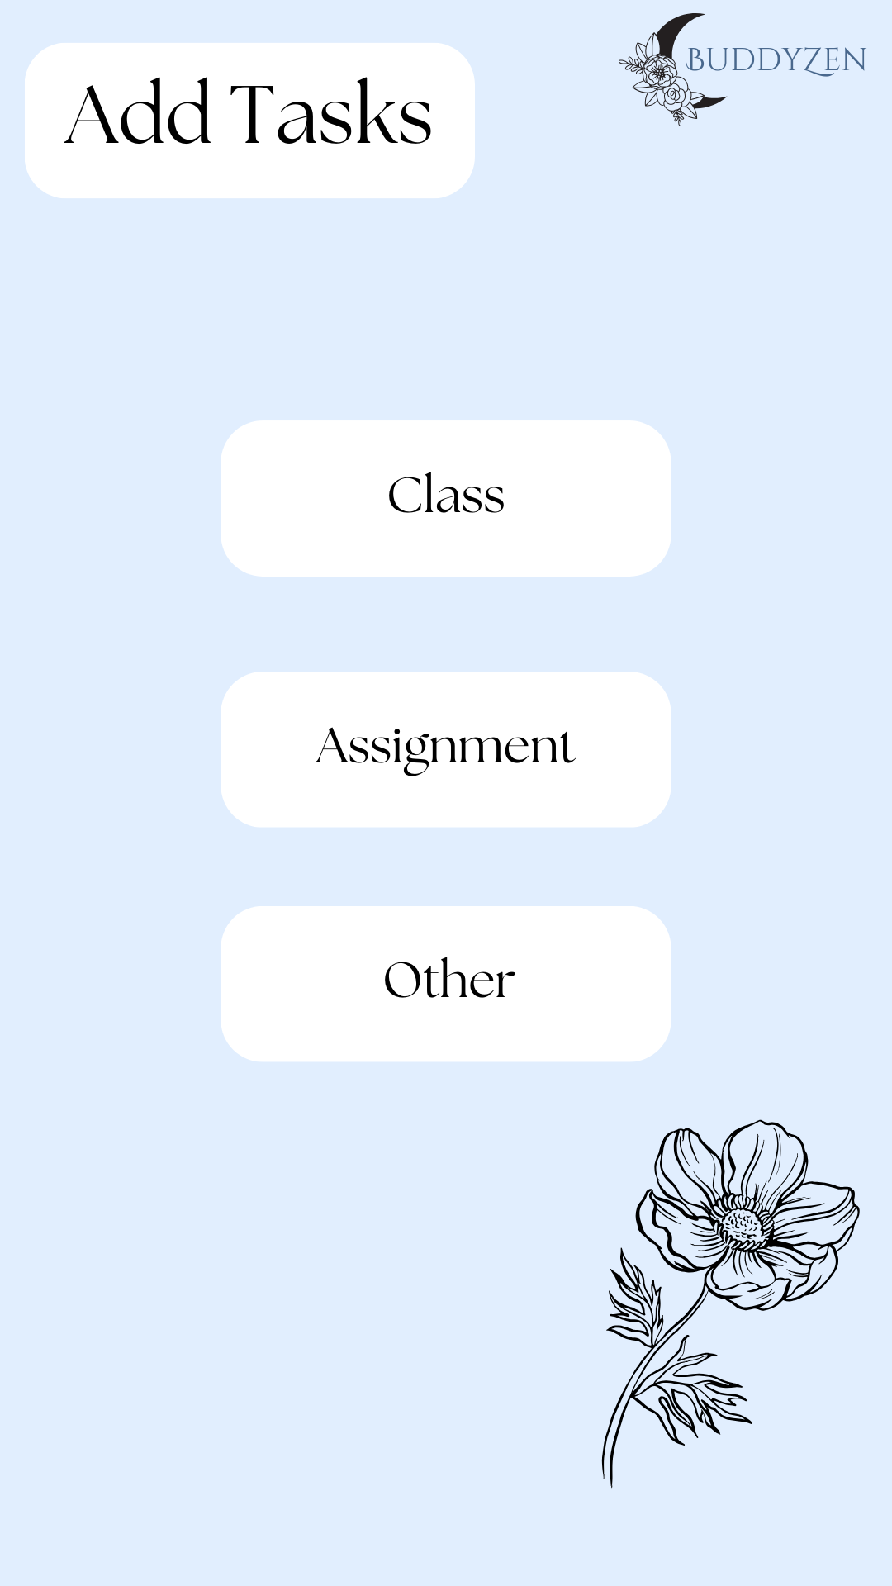
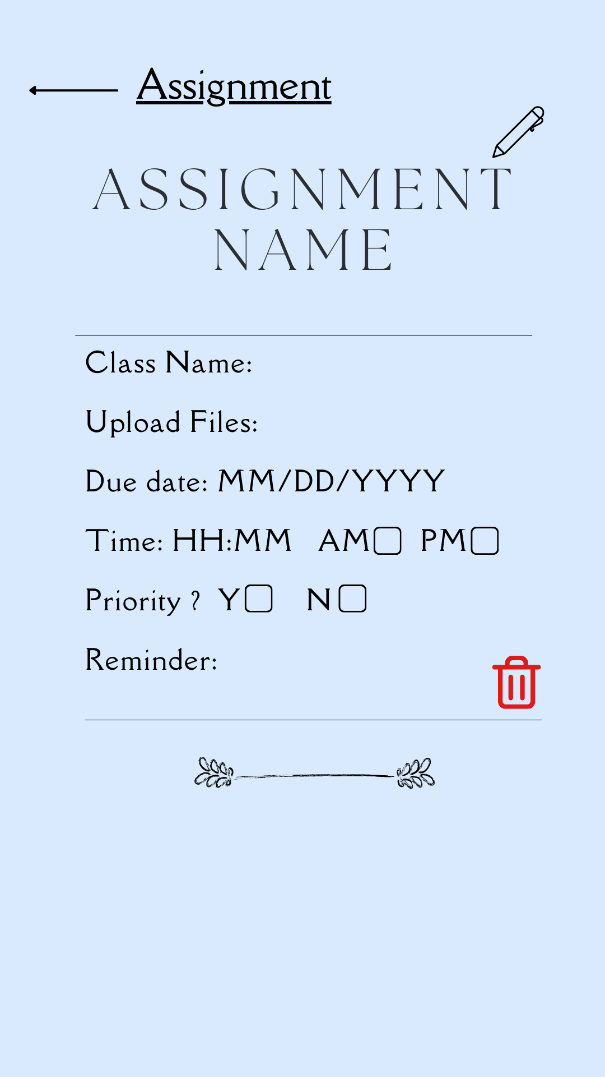
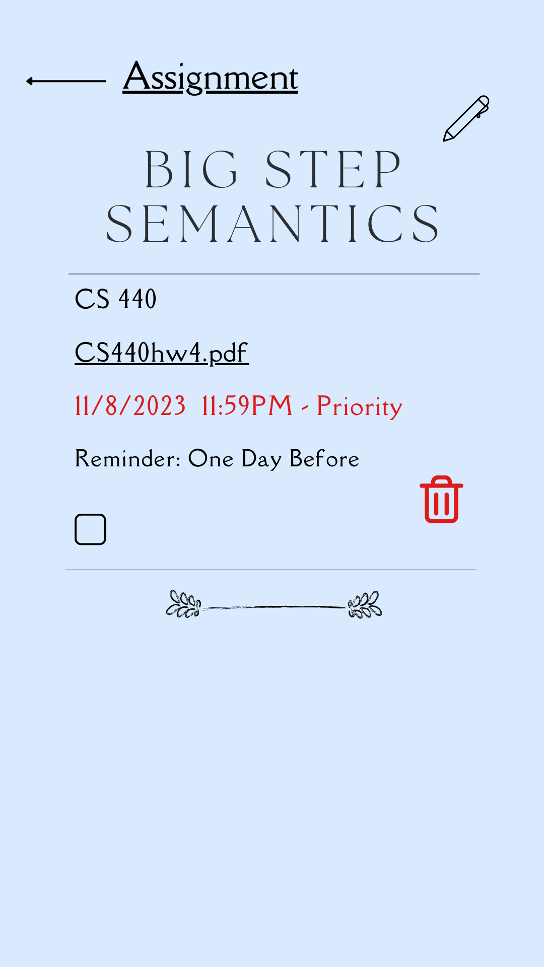
Test Case B
Notes:
Jenny
The user sets up their assignments in the calendar, including the due date for each assignment. The user will begin by clicking on tasks and will be prompted to add tasks, delete tasks, or modify tasks. The user will click add tasks then be prompted to select class, assignment,or other, they will be prompted to fill out…. Then once they filled it out they can click pencil button on the top right and save it to the calendar as well as be reminded

Slide 36
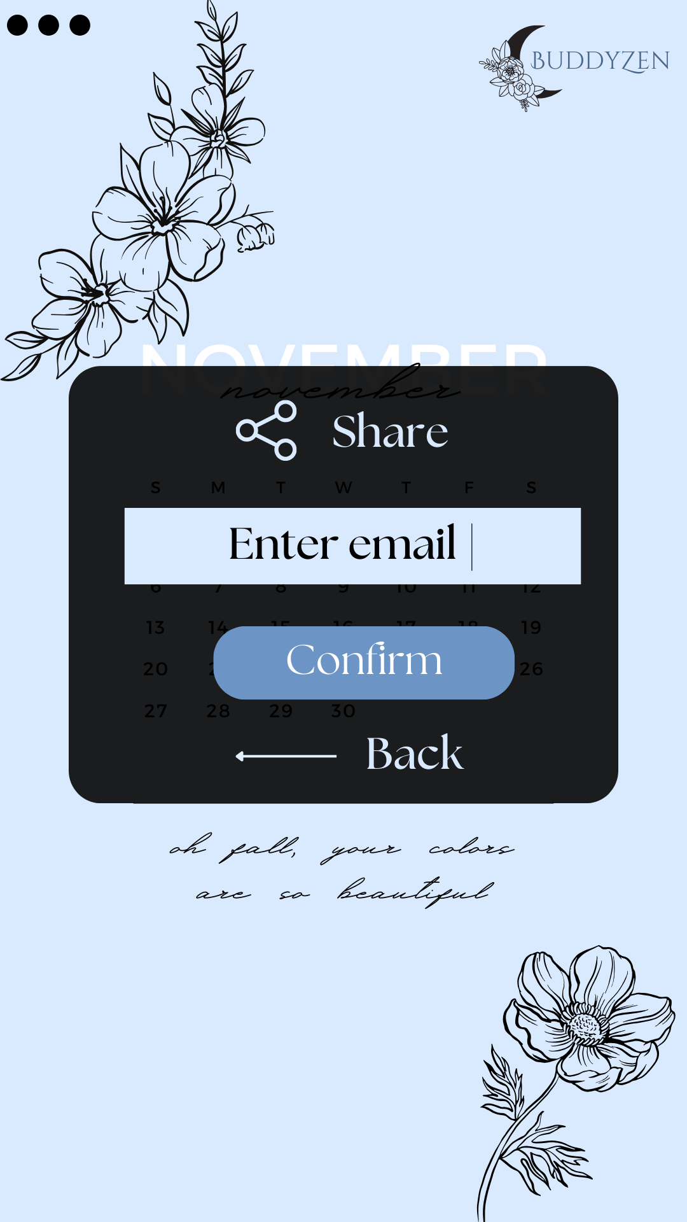
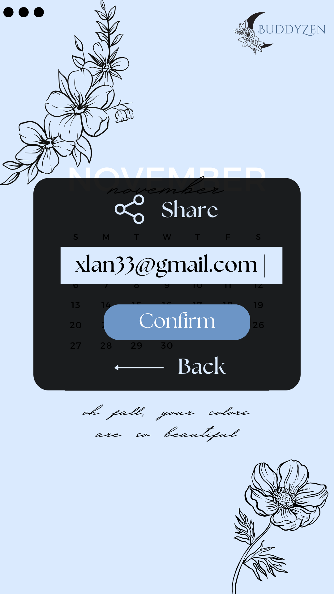
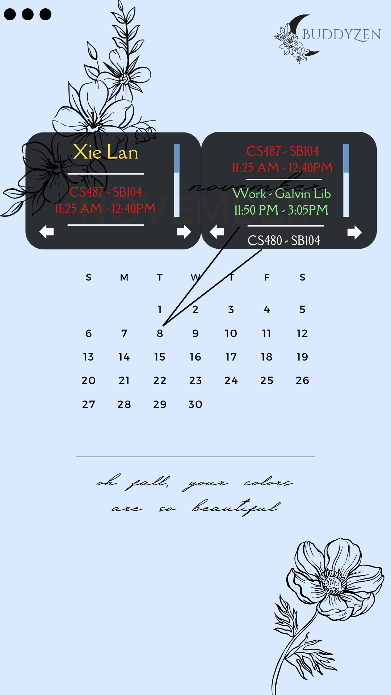
Test Case C
Notes:
Jenny
The user shares the calendar with another user on the app, making it possible for the user to view 2 schedules at the same time. User 1 can click the share button and will be prompted to a pop up to enter user 2s email. They will also be able to choose if they want to share assignments in this case the user chooses yes and in the calendar user 2 will be able to see two calendars and they will be different colors to easily distinguish between the two

Slide 37
Thank you!
Notes:
jenny

